Slide 1
Big Data Hadoop – Project Presentation
HASIT SYAL
Notes:
This template can be used as a starter file to give updates for project milestones.
Sections
Right-click on a slide to add sections. Sections can help to organize your slides or facilitate collaboration between multiple authors.
Notes
Use the Notes section for delivery notes or to provide additional details for the audience. View these notes in Presentation View during your presentation.
Keep in mind the font size (important for accessibility, visibility, videotaping, and online production)
Coordinated colors
Pay particular attention to the graphs, charts, and text boxes.
Consider that attendees will print in black and white or grayscale. Run a test print to make sure your colors work when printed in pure black and white and grayscale.
Graphics, tables, and graphs
Keep it simple: If possible, use consistent, non-distracting styles and colors.
Label all graphs and tables.

Slide 2

Overview
Study Links
Terminologies
GitHub
Project – Real time Application
Notes:
What is the project about?
Define the goal of this project
Is it similar to projects in the past or is it a new effort?
Define the scope of this project
Is it an independent project or is it related to other projects?
* Note that this slide is not necessary for weekly status meetings

Slide 3





Study Links
SLT SESSIONS
MR SESSIONS
HADOOP DEFINATIVE GUIDE BOOK
HADOOP APACHE
HADOOP TUTORIAL
STACK OVERFLOW
JAVA TUTORIAL
Notes:
Duplicate this slide as necessary if there is more than one issue.
This and related slides can be moved to the appendix or hidden if necessary.

Slide 4
Topic Flow
Bigdata & Hadoop
Architecture
HDFS
Map Reduce
MR1
MR2 / YARN
PIG
High Level Prog Language
PIG Commands
HIVE
Hive QL
SQL based querying Language
Notes:
The following slides show several examples of timelines using SmartArt graphics.
Include a timeline for the project, clearly marking milestones, important dates, and highlight where the project is now.

Slide 5

Terminologies BIG DATA
Big data is a term for data sets that are so large or complex that traditional data processing applications are inadequate to deal with them.
Volume
Velocity
Variety
Veracity

Slide 6
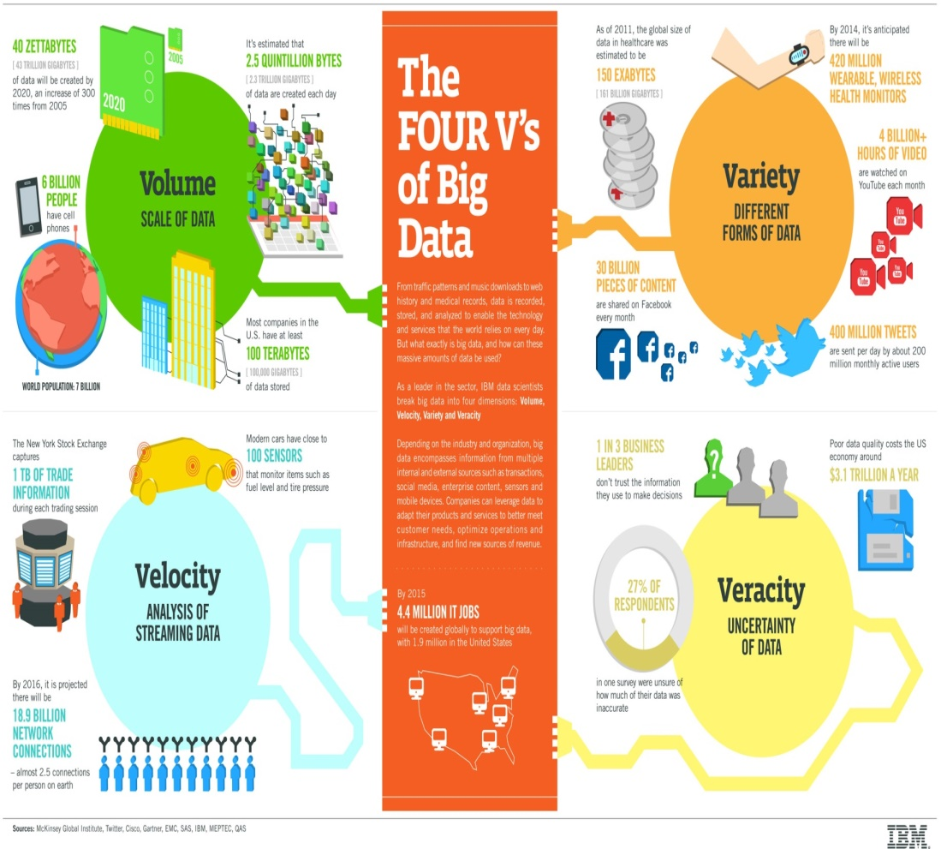
4v’s of BIG DATA
Volume-Defines the extreme amount of data.
Velocity- Defines the data that keeps on changing.
Veracity-Accuracy of data
Variety-Different forms of data such as Structured and semi-structured and unstructured

Slide 7

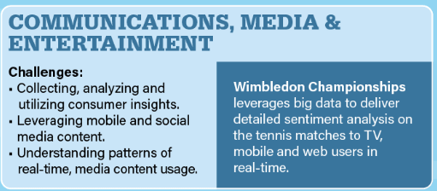
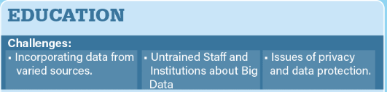



Government Operation: National Archives and Records Administration, Census Bureau.
Commercial: Finance in Cloud, Cloud Backup, Mendeley (Citations), Netflix, Web Search, Digital Materials, Cargo shipping (as in UPS.
Defense: Sensors, Image surveillance, Situation Assessment
Healthcare and Life Sciences: Medical records, Graph and Probabilistic analysis, Pathology, Bioimaging, Genomics, Epidemiology, People Activity models, Biodiversity
Energy: Smart grid
Deep Learning and Social Media: Driving Car, Geolocate images/cameras, Twitter, Crowd Sourcing, Network Science, NIST benchmark datasets.
The Ecosystem for Research: Metadata, Collaboration, Language Translation, Light source experiments.

Slide 8



Terminologies HADOOP
Apache Hadoop is an open-source software framework used for distributed storage and processing of very large data sets
It consists of computer clusters built from commodity hardware
All the modules in Hadoop are designed with a fundamental assumption that hardware failures are a common occurrence and should be automatically handled by the framework
Hadoop Components
HDFS(Storage)
Map Reduce
Process/Compute

Slide 9
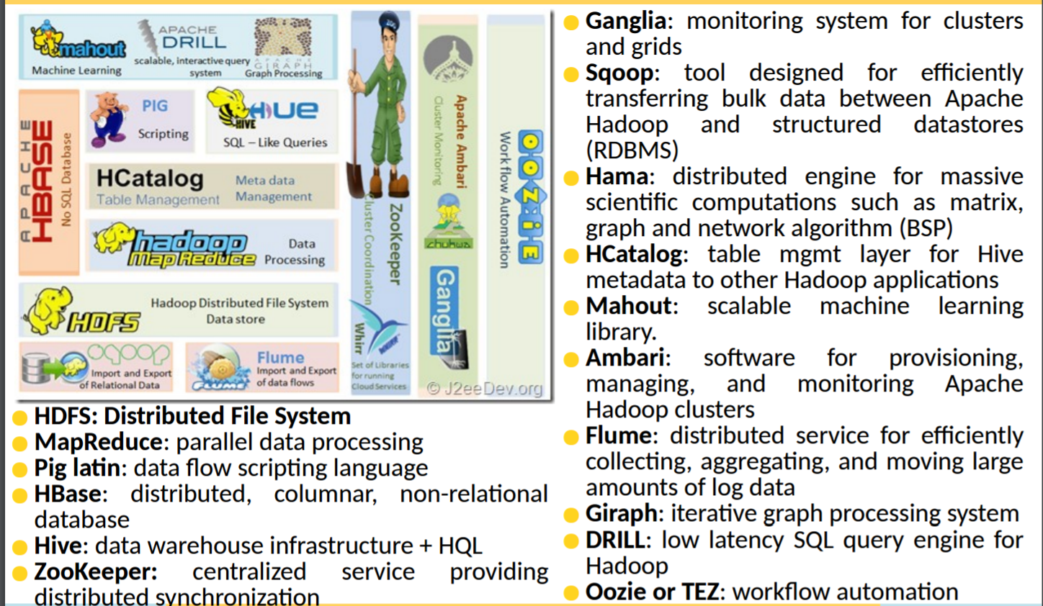
Terminologies Map Reduce, PIG, HIVE, SQOOP,FLUME,HBASE,OOZIE,ZOOKEEPER

Slide 10



Project ON H1B VISA
Abstract
In this CASE STUDY, we will be performing analysis on the H1B visa applicants between the years 2011-2015. After analyzing the data, we can derive the following facts
Highlights :
Technology Used :
MR Techniques.
Hive QL
PIG Latin Language
SQOOP

Slide 11
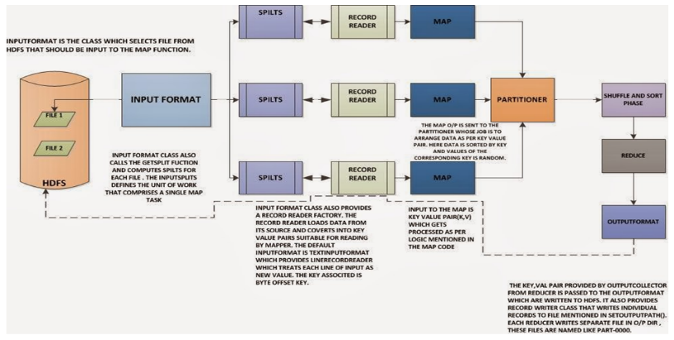
Apache Hadoop – Map Reduce Work Flow

Slide 12
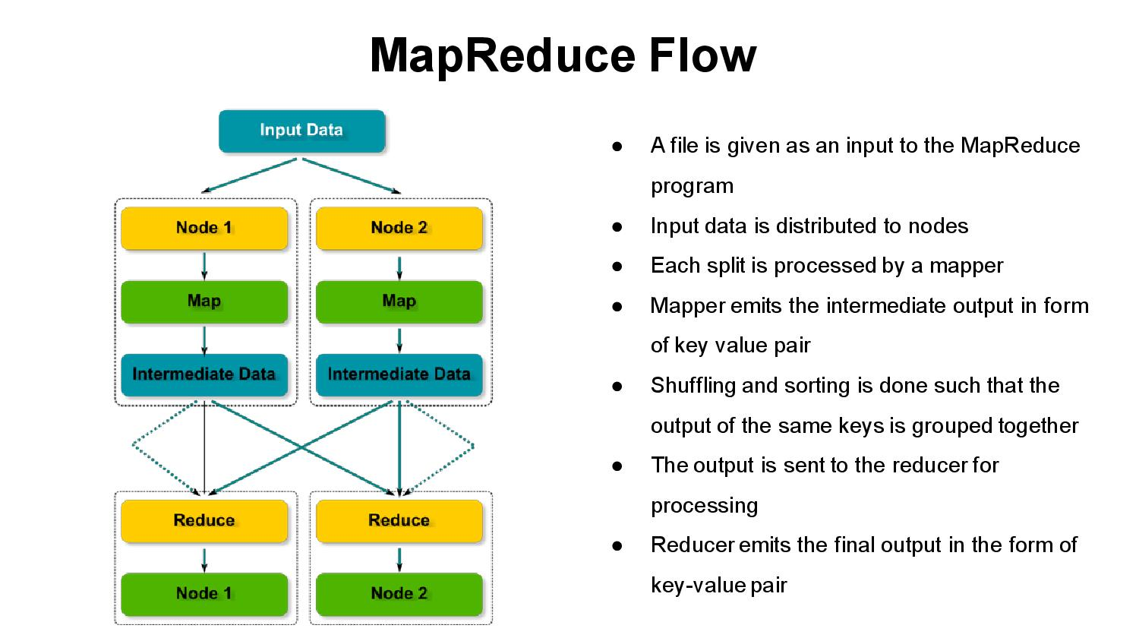
Concepts we learnt
Simple Map Reduce Java Project
Mapper
Combiner
Partitioner
Reducer
Advance Map Reduce Java Project
Simple Map Reduce app plus
b. Record Reader
Map-Side Join
Reducer-Side Join

Slide 13
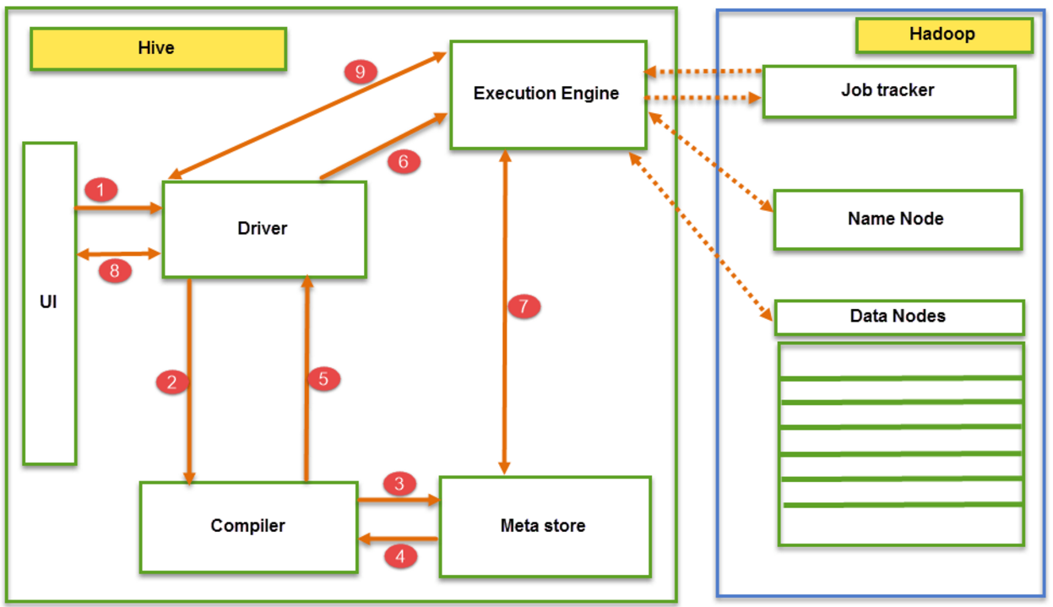
Apache Hive – Data Flow

Slide 14

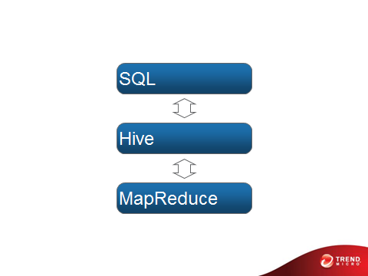
Concepts we learnt
Create table
Load data
Export data

Slide 15
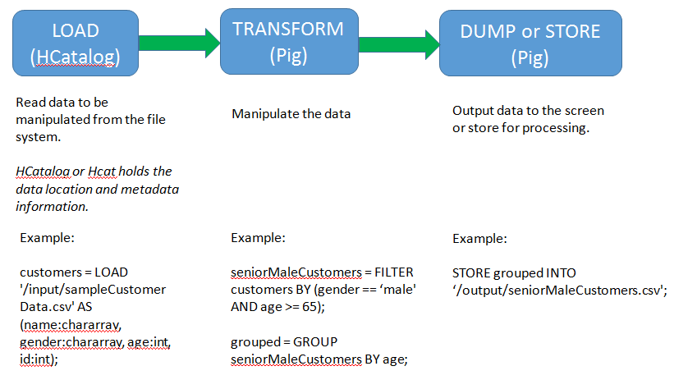
Apache Pig – Data Flow

Slide 16



Concepts we learnt
A high-level scripting language (Pig Latin)
Process data one step at a time
Simple to write MapReduce program
Easy understand
Easy debug
LOAD data
FILTER data
GROUP data
JOIN data
DUMP AND STORE data

Slide 17
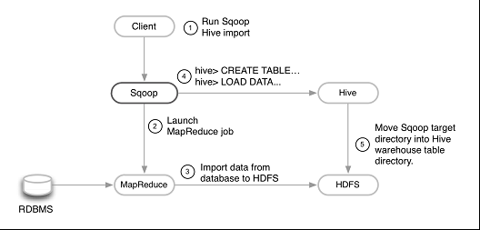
SQOOP- DATA FLOW

Slide 18
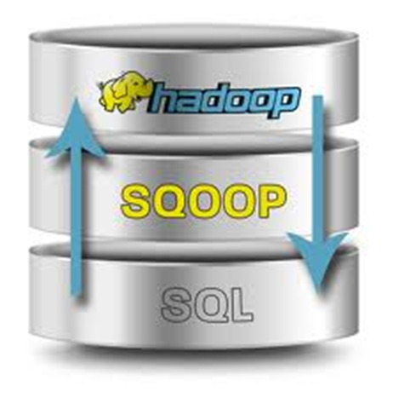
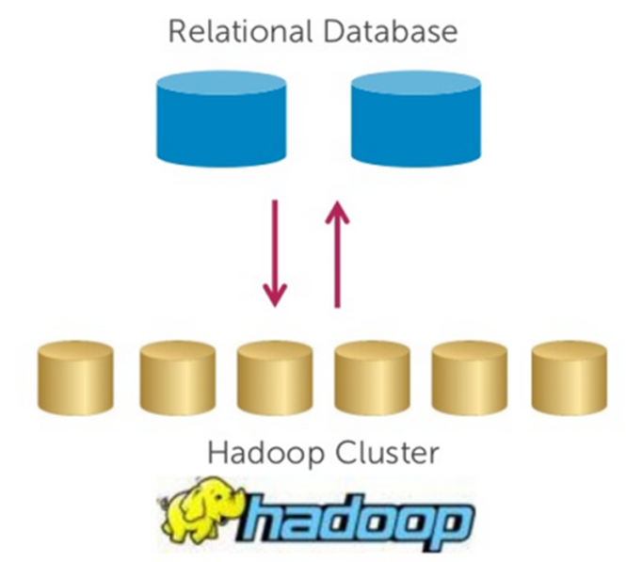
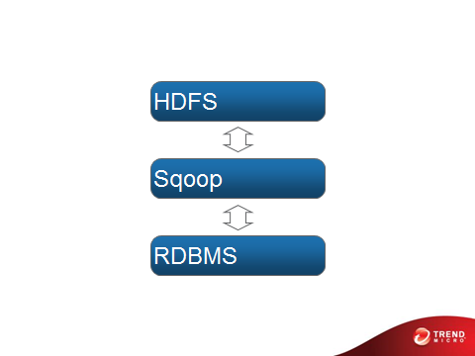
Concepts we learnt
Easy, parallel database import/export
What you want do?
Insert data from RDBMS to HDFS
Export data from HDFS back into RDBMS

Slide 19
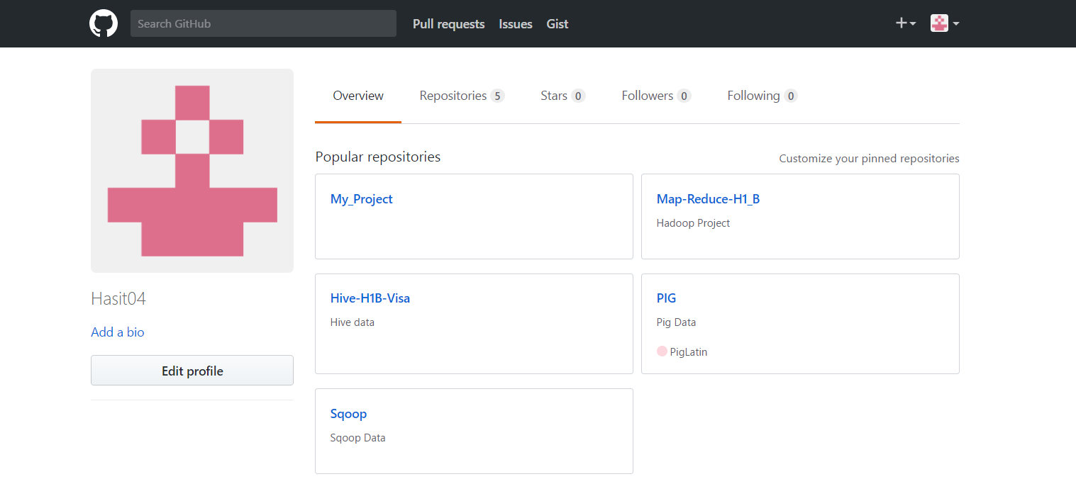
GitHub

Slide 20
Future Scope
Project
BigData
Hadoop
Map Reduce
PIG
Future Enhancement
OOZIE
Project 1- User Personalization
Project 2 – Education Business
Notes:
What are the dependencies that affect the timeline, cost, and output of this project?

Slide 21

“Thanks to Big Data . Machines Can be Now Programmed to do the next thing Right .. But only Developers can do the next Right Thing “

Slide 22





